Slide 1

TPS Reporting’s Weekly Report #2
Team Leader: Nicholas Alcorn
Other Members: Trevor Bal, Carl Moon II, Yasmina Rabhi, & Cameron Randolph

Slide 2
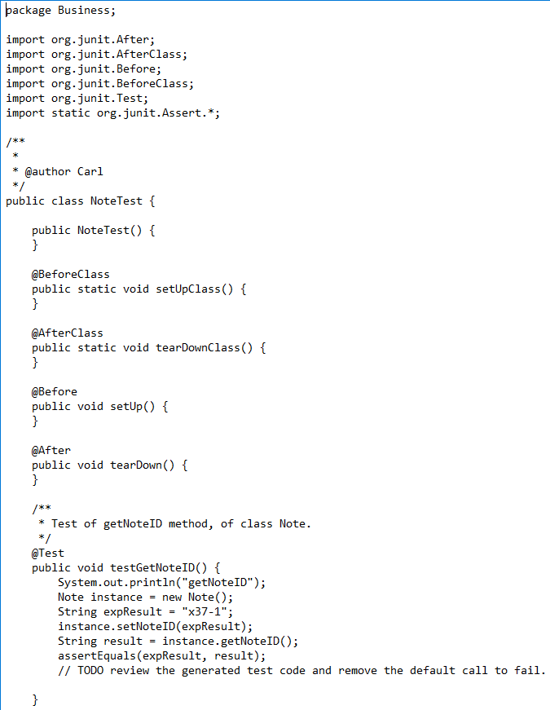
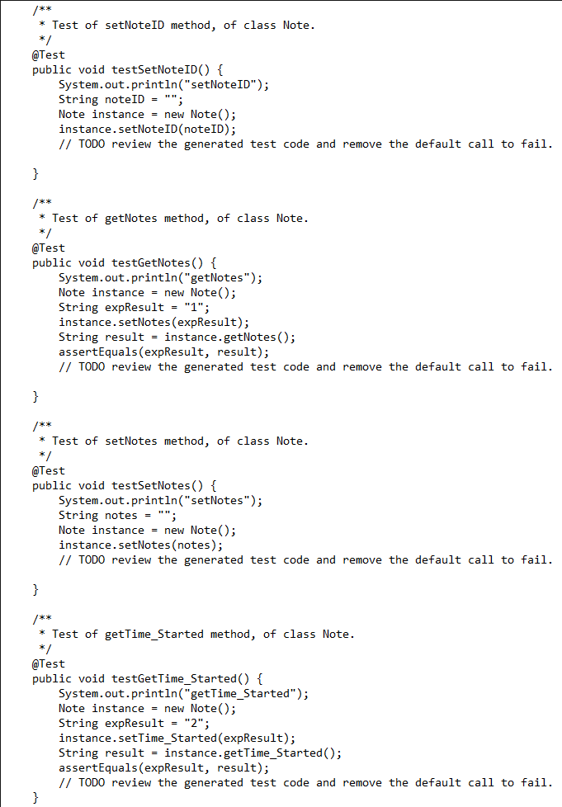
Tests

Slide 3
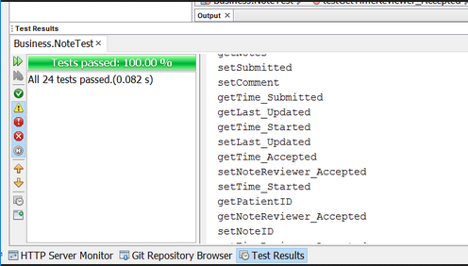
Tests

Slide 4
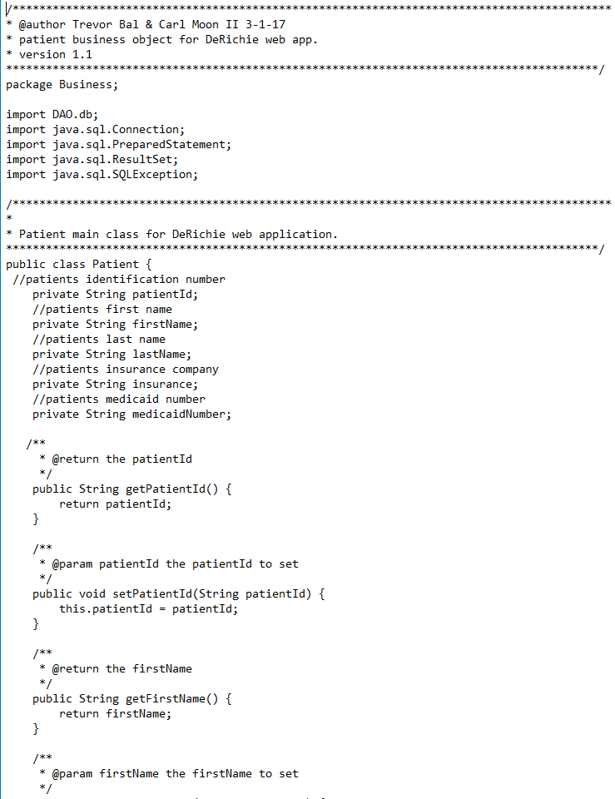
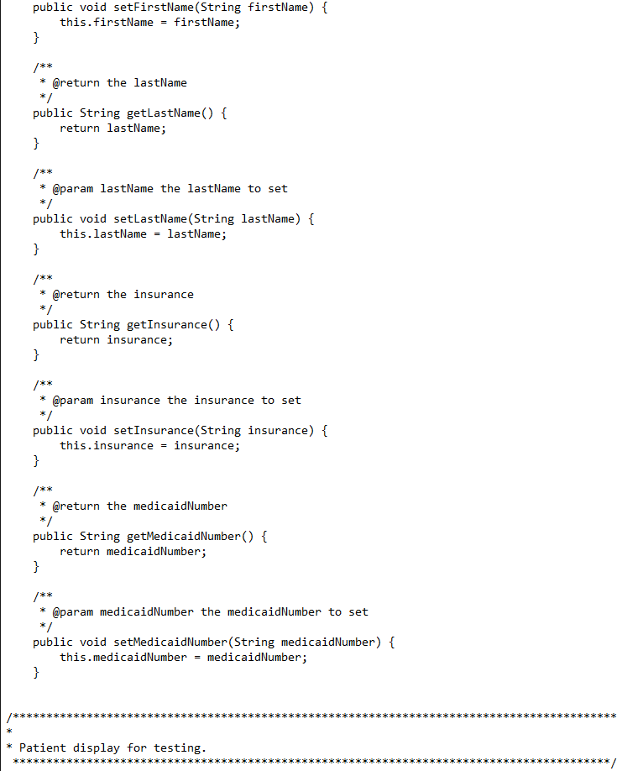
Running Code

Slide 5
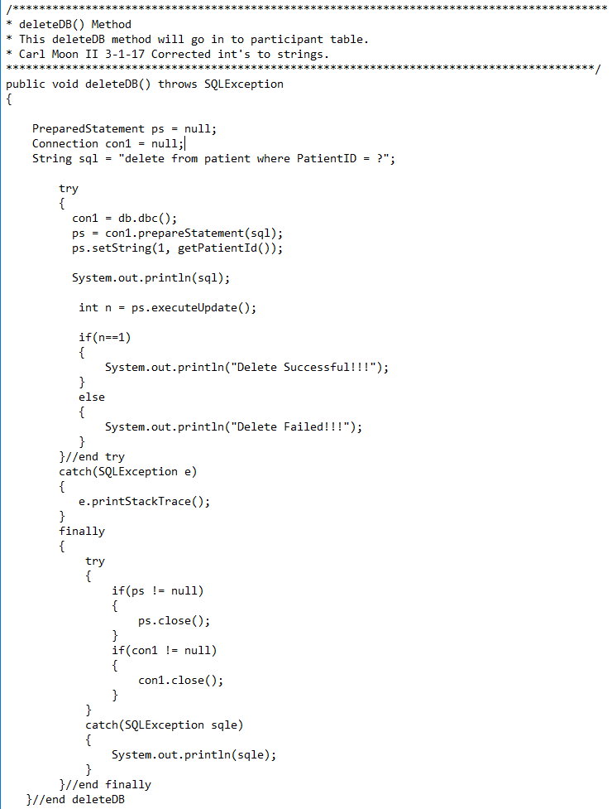
Running Code (Continued)

Slide 6
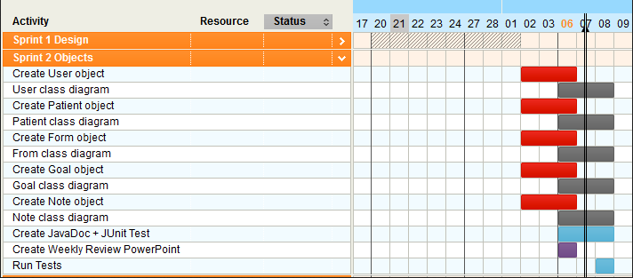

Project Plan

Slide 7
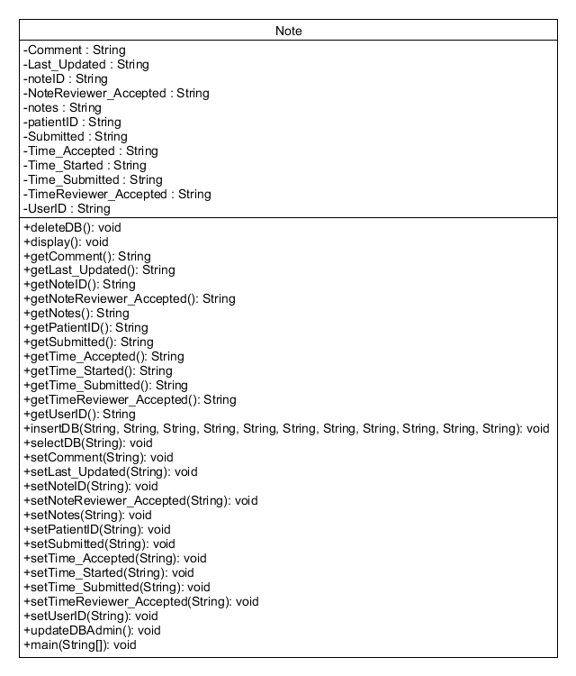
Deliverables

Slide 8
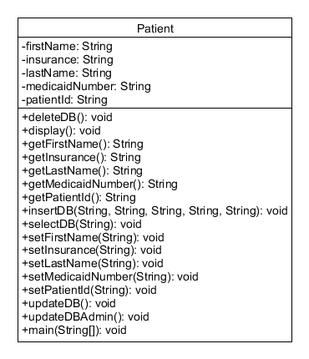
Deliverables (Continued)

